Slide 1
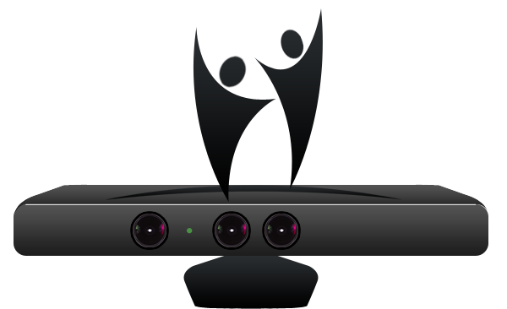
KinectoTherapy

Slide 2
Introduction
According to the World Health Organization, 650 million people in the world are disabled.
80% of disabled people live in developing countries.
Data: Census, 2001

Slide 3
Target Audience
Our software aims at aiding people to overcome motor disorders caused by cerebral palsy, spinal cord injury, post stroke or hereditary muscle ailments.
The software aims to extend a person’s range of motion and his ability to make coordinated movements.
Data: World bank’s report
On India 2002
Notes:
All these people who are physically handicapped irrespective of the cause, need Physiotherapy or Occupational therapy for recovery and motor and neural reorganization.

Slide 4
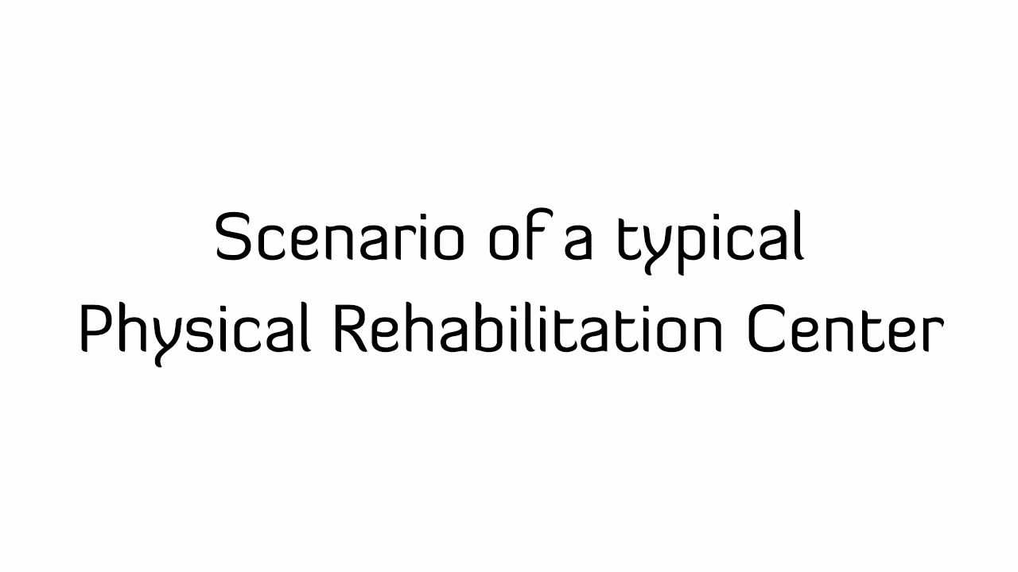
Video
Notes:
In order to explain the current scenario in physical Rehabilitation, let’s just look at a video of a typical rehabilitation centre.

Slide 5
Problems
Patients don’t want to visit rehabilitation clinic regularly
Patients can’t track their own progress.
Conventional Therapy doesn’t engage and motivate people.
Exercise are perceived monotonous and repetitive by patients.

Slide 6
Current solutions
Normal machines
Sensory attachments
Wii Therapy
Expensive
Can’t be used at home
Needs supervision
Requires training
Patient feels bound
Full body not covered
Requires sensor to be held

Slide 7
Key to Effective Rehabilitation
Repetition
Feedback
Motivation
Effective Rehabilitation
Notes:
Medical terms

Slide 8
Demo

Slide 9
Features
4 Motion sensing exercise routines
Use of Natural User Interface
Full body motion sensing, Gesture Recognition
Customizable variables
Interactive Auditory and Visual feedback mechanism.
Patient profiles and Data Logging Mechanism
Website
Remote access for doctors
Selective retrieval of performance logs
Quick decision making through graphs
Patient profiles
Notes:
Value proposition

Slide 10
Soft Architecture
Application
Microsoft Kinect
Unity 3D Game Engine
Microsoft Kinect
.NET Framework
Unity Web Player
Microsoft Kinect Drivers
HTML/CSS
Windows 7
SQL Server 2008
ASP .Net MVC 3

Slide 11

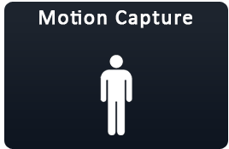


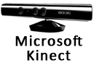



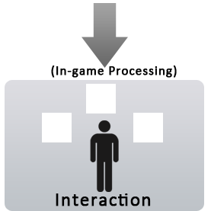

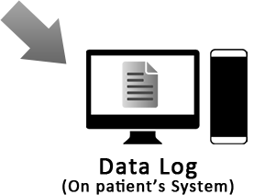

Software Design

Slide 12
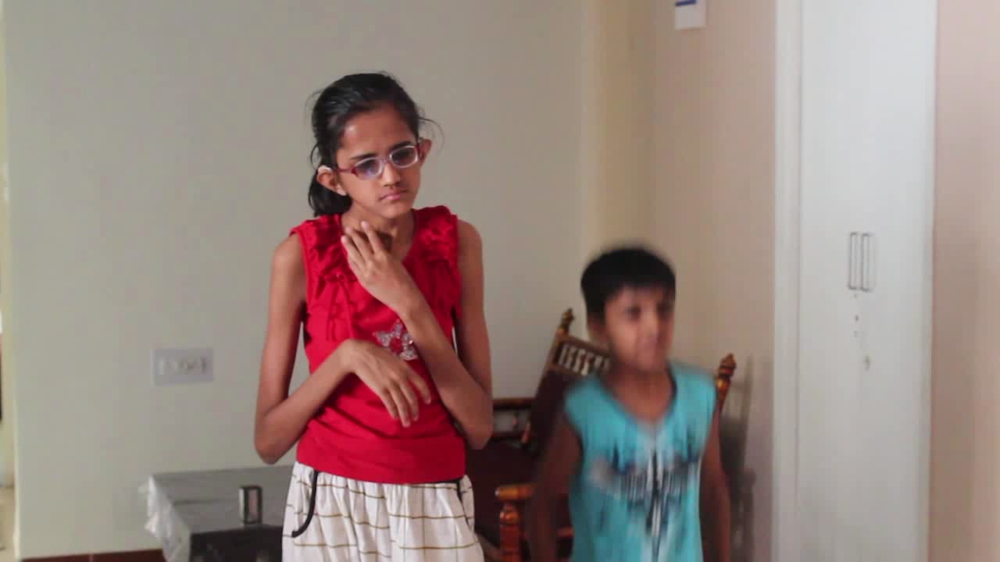
User Studies and Usability Testing

Slide 13
Market Size
2001:20 -- 2011:36 million disabled people
12.6 million have movement related disorders
Computer penetration
Urban: 40%
Rural: 5%
Target Group
Disabled
Computer Users
Data: Census India, NASSCOM

Slide 14
3-Tier Business Plan
Corporate hospitals
Private Clinics
5x Licenses – 1lac
Basketing Exercise Routines
Individual Patients
Different pricing for Rural and Urban areas.
20x Licenses – 5lac
Usage per day
IP specific license
Usage per hour
Renewed annually
Starting in phase 2
Resident Engineer
Notes:
CSR, demo games

Slide 15
Market penetration forecast

Slide 16
Capacity building
Kinectotherapy
Hospitals
Govt.
Notes:
Measurable and sustainable result

Slide 17
Acknowledgment
Dr. Anil Roy – Professor DAIICT
Specialists
Dr Vani Gupta- Occupational Therapist, New Delhi
Dr Chandola- Sports Medical Supervisor, Safdarjung Hospitals, New Delhi
Dr Anjali Bhise, HOD Physiotherapy, Civil Hospital, Ahmedabad, Gujarat.
Dr Yagna, Physiotherapist, Civil Hospital, Ahmedabad, Gujarat
Users
Mahika and Rajat
Manjeet
Technical guidance
Sumit Mackwana and Rochak Maheshwari

Slide 18


